Slide 2
EMC 2017 Chapter Chair Dinner and Training Event
IEEE EMC Society - Region 9 Chapters
Argentina, Brazil, Colombia

Slide 3
South America & Region 9 Chapters
Argentina (Buenos Aires AP/EMC Joint Chapter)
Creation: 2011 (AP/EMC Joint Chapter)
Chapter Chair : Gustavo Fano
E-mail: gustavo.gf2005@gmail.com
South Brazil Chapter (São Paulo)
Creation: 2000
Chapter Chair: Carlos Sartori
sartori@pea.usp.br
Colombia (Bogota)
Creation: 2007
Chapter Chair : Camilo Younes-Velosa
E-mail: cyounesv@unal.edu.co

Slide 4
Argentina Chapter
Location : Buenos Aires, Argentina
Creation: 2009
Main Events (2011– 2014)
Symposium EMC AP IEEE (ARGENCON 2011, ARGENCON 2013)
2015
May 5th : Prof. Ram Achar "Demystifying Signal Integrity in High-Speed Designs“
XVI Reunión de trabajo en Procesamiento de la Información y Control
2015. RPIC 2015 . October 5th - 9th, 2015 (Topics of EMC)
2016
ARGENCON 2016 - June 15 - 17, 2016 (3rd Edition)
GEMCCON 2016 – November 7 - 9, 2016 (2nd Edition)

Slide 5
Colombia Chapter
Location : Bogota, Colombia
Creation: 2007
Main Events (2007– 2016)
SICEL (Biannual International Seminar on Power Quality )
May 5th , 2015 : Prof. Ram Achar "Demystifying Signal Integrity in High-Speed Designs“

Slide 6
South Brazil Chapter
Location : São Paulo, Brazil
Address: Escola Politécnica - University of São Paulo (EPUSP)
Creation: 2000 (First Chapter in Region 9)
Main Goals
Promote the EMC in Brazil , South America & Region 9
Cooperation and Interchange between Region 9 & Others

Slide 7
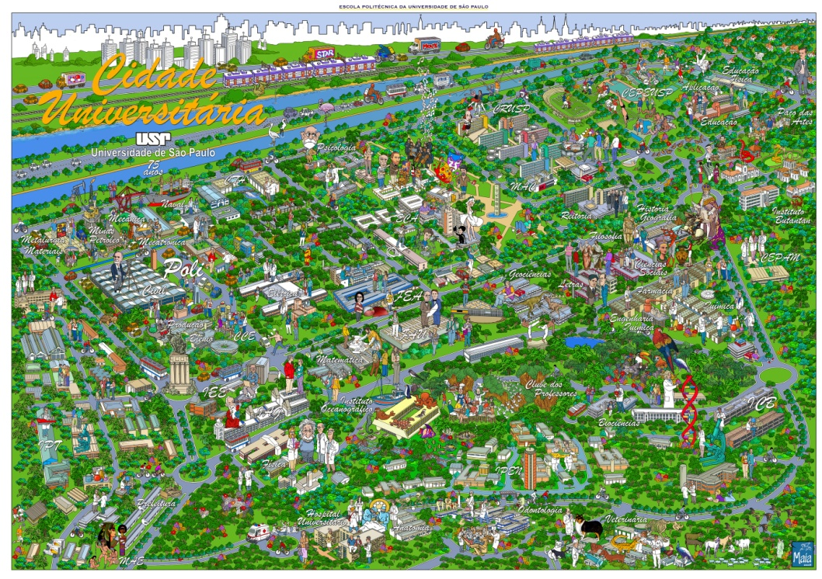
South Brazil Chapter
São Paulo
Area : 1 523 km² (2015)
Population ~ 11.9 million
Metropolitan Area ~20.3 million
Industries …
University of São Paulo
Teaching and research Units: 42/87
Technicians & Administrative: 17.199
Professors: 6.090
Students: 94.875
Undergraduate: 59.081; Graduate: 30.039 ...
South Brazil Chapter: 22 Members (Aug 2014)

Slide 8
South Brazil Chapter
Main Events (2000 – 2014)
Workshop on Biologic Effects (2001)
EMC Brazil (2002, 2004, 2011, 2012)
EMC BoD Meeting (November 2002)
Invited lectures (DL, etc.)
2015
May 5th : Prof. Ram Achar "Demystifying Signal Integrity in High-Speed Designs“
Lectures on Fundamentals of EMC and STDs
2016
Lectures on EMC (Fundamentals) & EMC Risk Management
2017
Lectures on EMC (Fundamentals)
GEMCCON 2017 November 08-10, 2017 (São Paulo): http://gemccon2017.emcss.org/

Slide 9
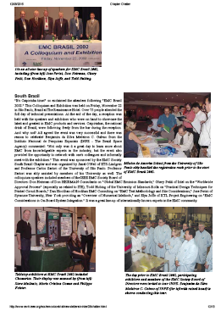
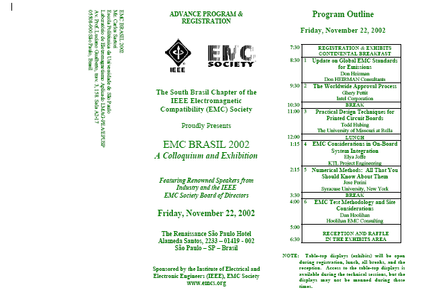
South Brazil Chapter Illustrations & Photos

Slide 10
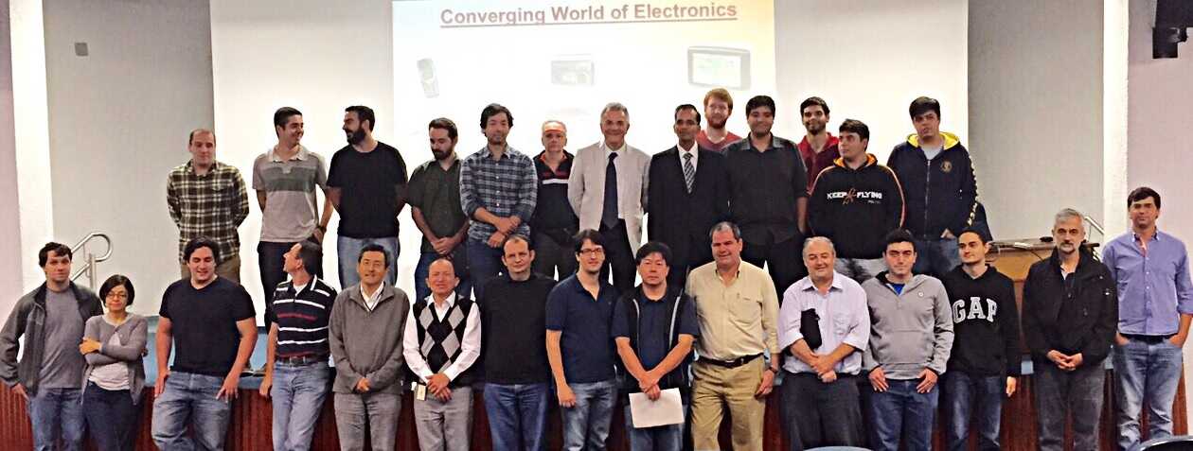
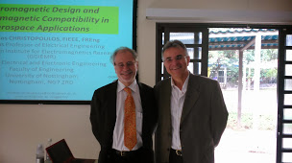
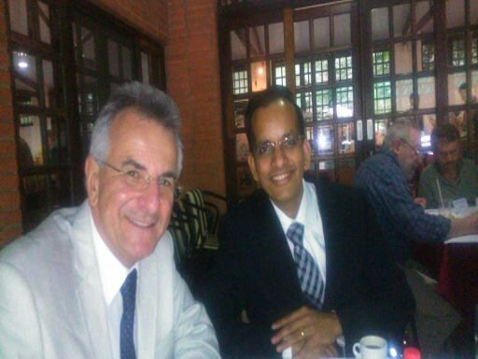
South Brazil Chapter Illustrations & Photos

Slide 11
EMC 2017 Chapter Chair Dinner and Training Event
Prof. Carlos Sartori
South Brazil Chapter Chair
EMC BoD Member
sartori@pea.usp.br

